Slide 1

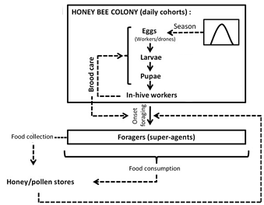
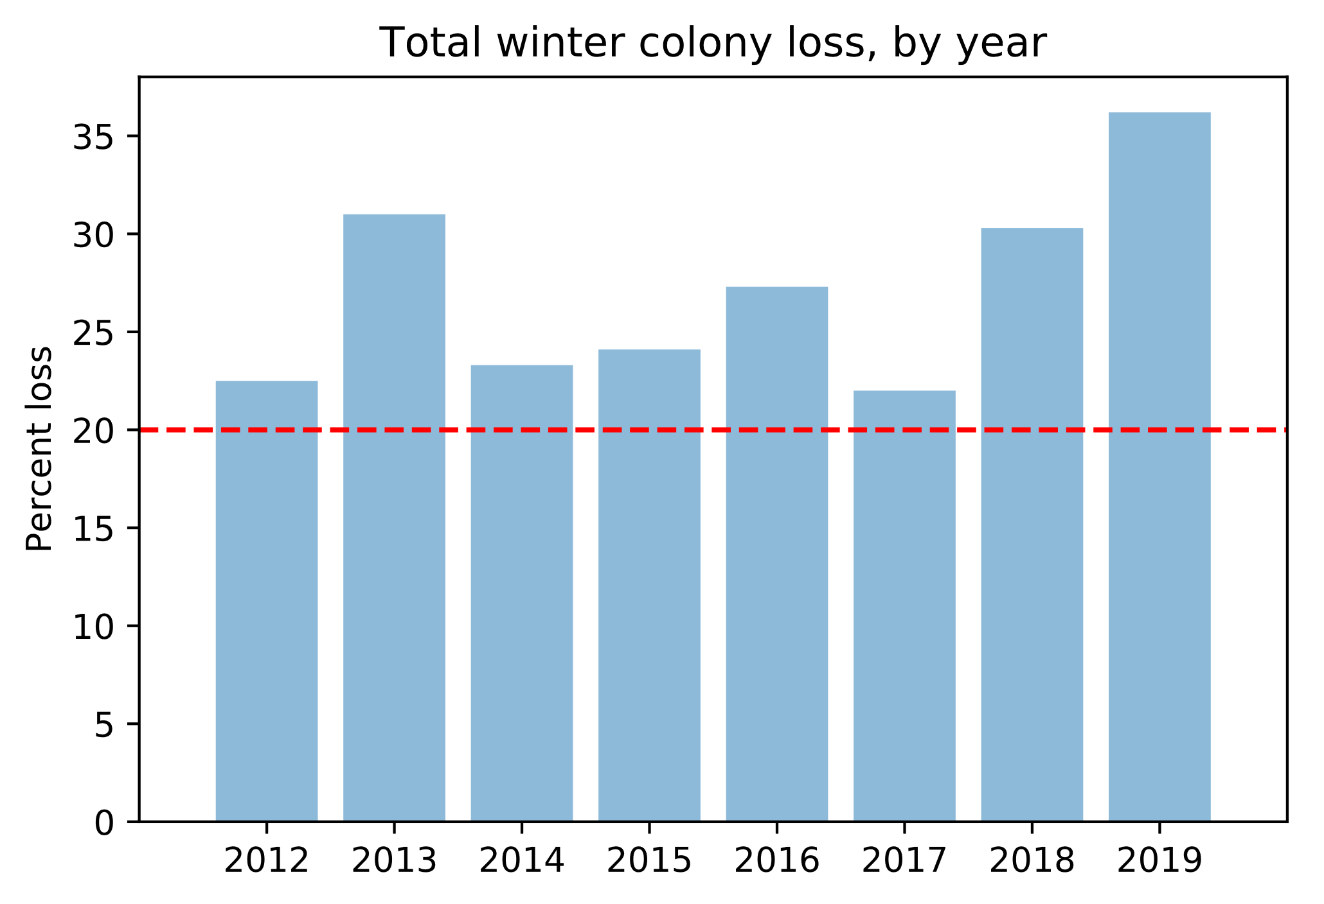
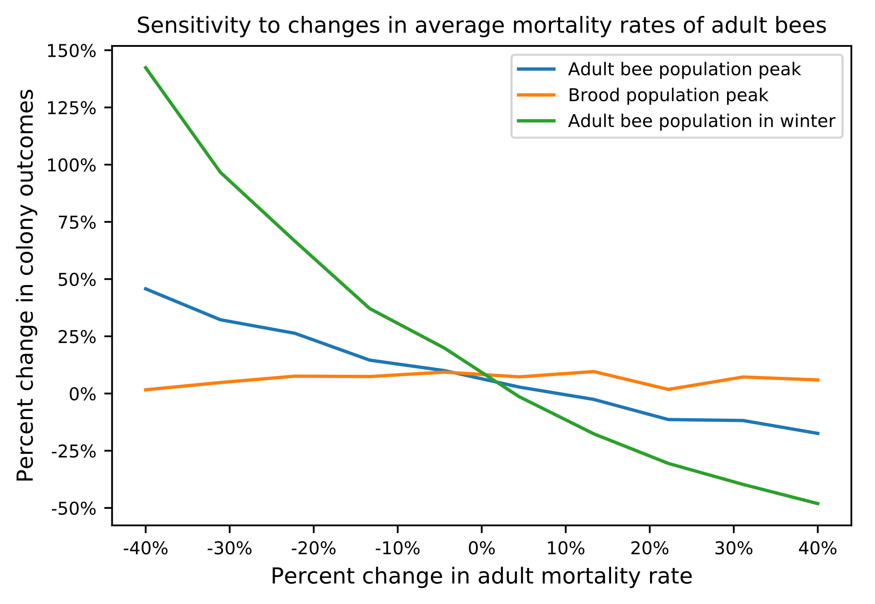
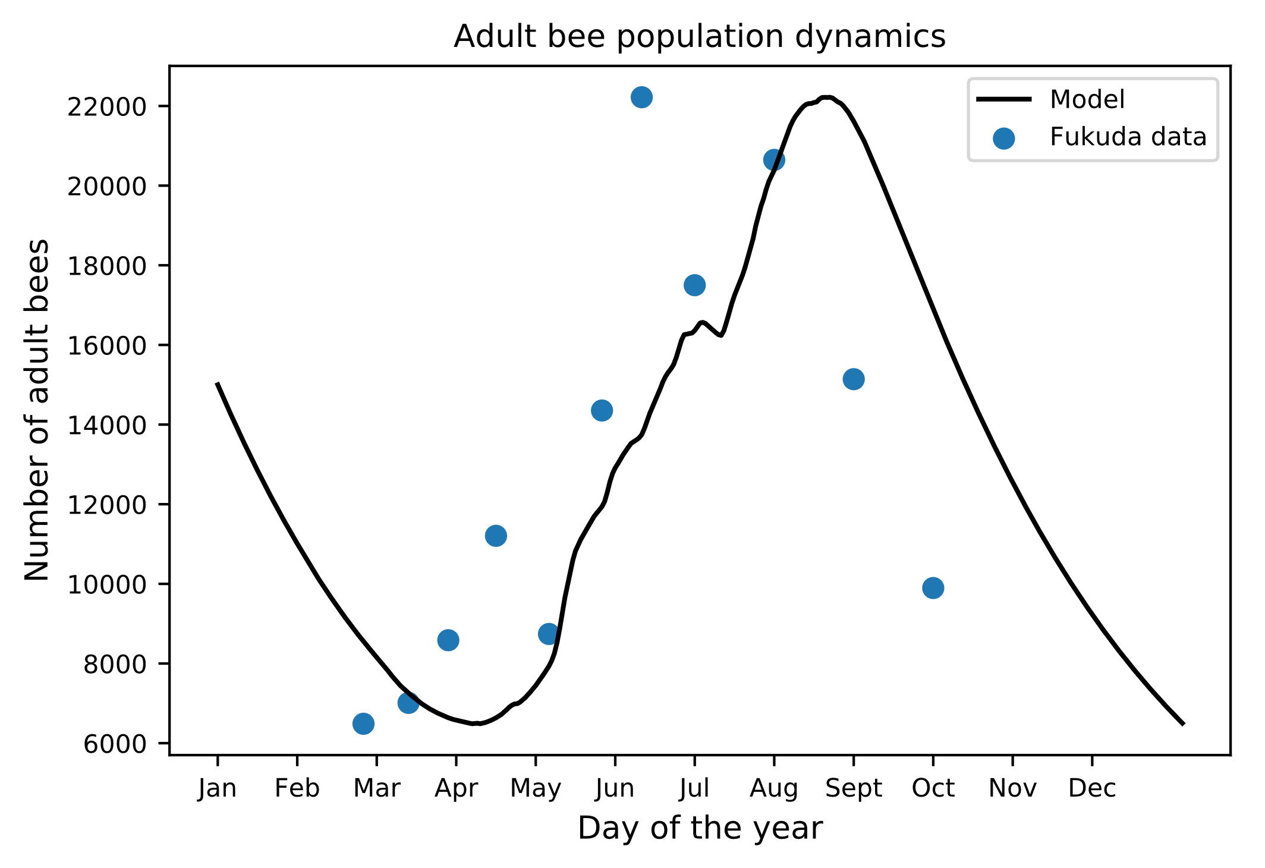
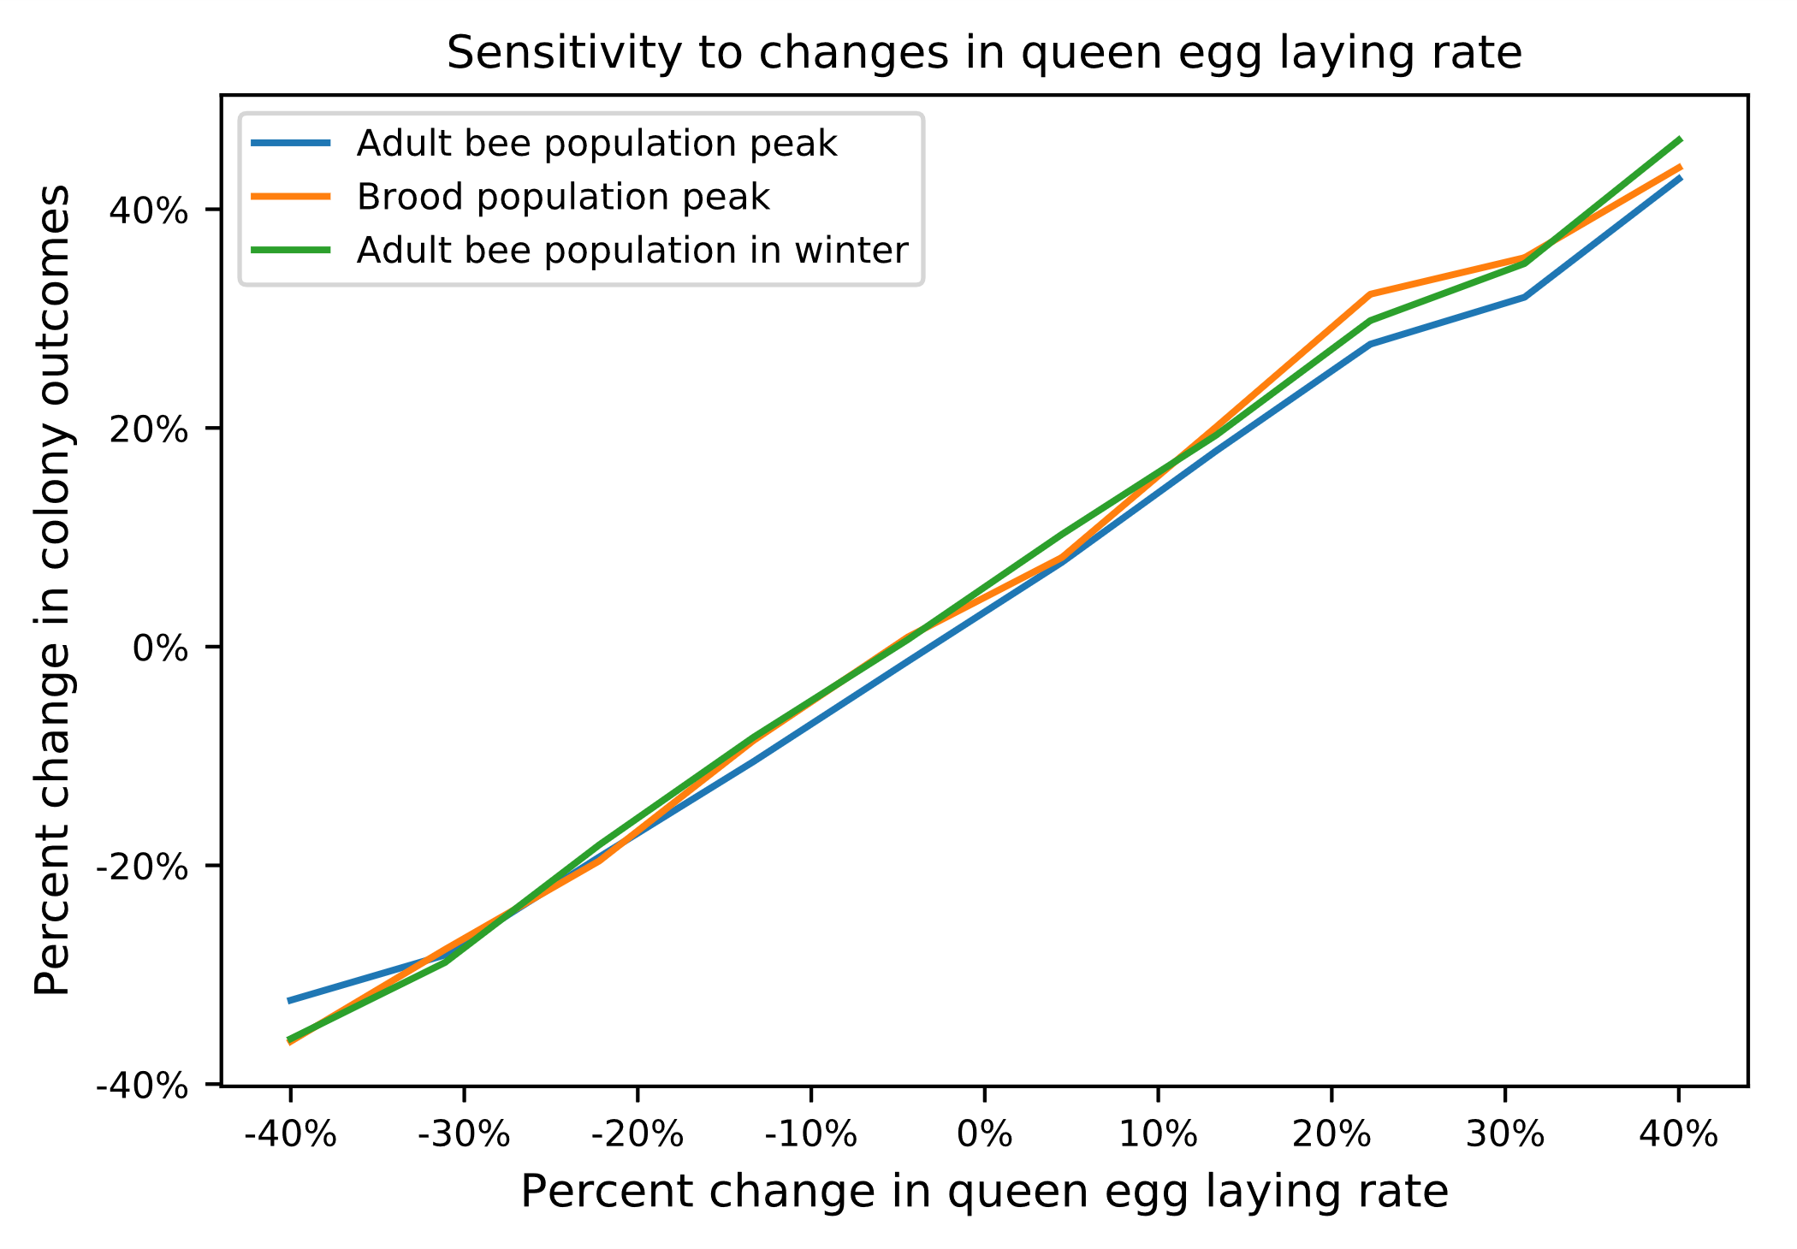
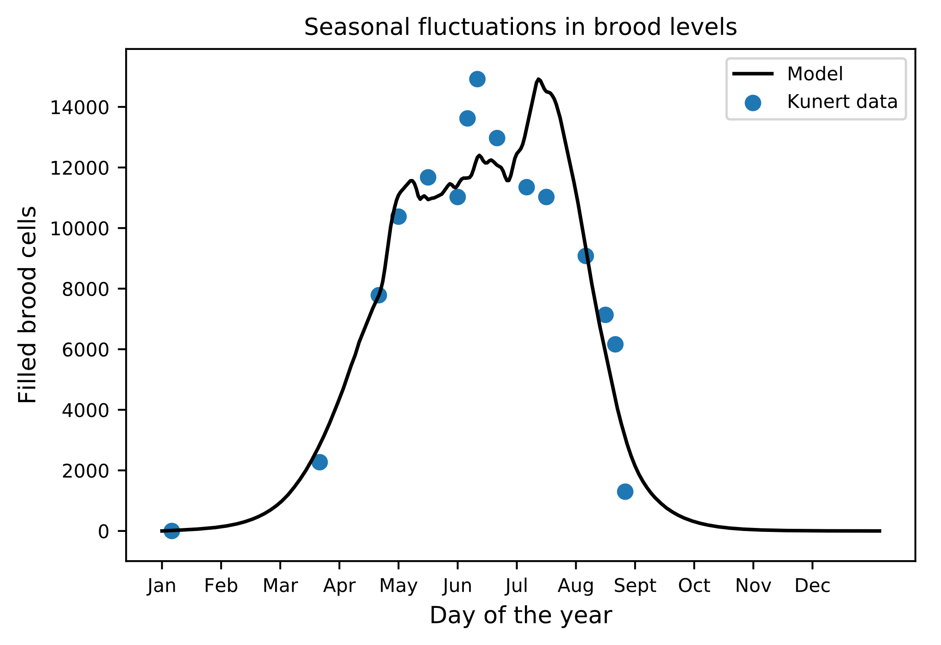
Drivers of Honeybee Colony Population Outcomes
PJ Wilkens
Crisis of honeybee colony loss
Model and validation
Results of sensitivity analysis
Queen egg laying rate and adult bee mortality rates were the most influential input parameters across population metrics
Introduction
Total annual losses of honeybee colonies in regions with developed beekeeping communities have been consistently increasing for decades, now >20%/winter
There is significant concern over the sustainability of existing stocks and their ability to meet the demand for crop pollination
The increasing colony loss is likely due to many factors, including parasites, pathogens, pesticides, habitat loss, poor beekeeping practices, etc.
Currently available hive sensors don’t track representative data to allow for real-time predictive modeling of population outcomes
In order to develop the appropriate sensor technology to enable the development of predictive beekeeping tools, it is essential to determine the factors and qualities of honeybee colonies that drive population outcomes
Methodology
Build a behavioral model of the internal colony dynamics of Apis mellifera mellifera beehives
Test model against empirical results for validation
Complete a sensitivity analysis on the model to identify which input parameters have the greatest effect on 3 key hive population outcomes:
Peak adult bee population
Peak brood population
Population of adult bees during winter
To simplify the initial state of the modeled beehives, for all simulations, we assume:
Hives are started on January 1st when packaged bees are installed with beekeeper provided sugar and the queen begins laying
No inclement weather to affect foraging
There is no beekeeper or pest intervention after the first day
Developed following the core feedback loops, functions, and assumptions of the Beehave Colony Dynamics and HoPoMo models
Results
Since queen egg laying rate and adult bee mortality rates were determined to be the most influential parameters on population outcomes, developing methods to track these values is crucial
Collecting this relevant data will also allow us to further validate and refine our model
Bibliography
Becher, M., Grimm, V., Thorbek, P., Horn, J., Kennedy, P., & Osborne, J. (2014). BEEHAVE: a systems model of honeybee colony dynamics and foraging to explore multifactorial causes of colony failure. Journal of Applied Ecology, 51(2), 470–482. https://doi.org/10.1111/1365-2664.12222
Becher, M., Osborne, J., Thorbek, P., Kennedy, P., & Grimm, V. (2013). REVIEW: Towards a systems approach for understanding honeybee decline: a stocktaking and synthesis of existing models. Journal of Applied Ecology, 50(4), 868–880. https://doi.org/10.1111/1365-2664.12112
Fukuda, H. (1983) The relationship between work efficiency and popula-tion size in a honeybee colony.Researches on Population Ecology,25,249–263.
Khoury DS, Barron AB, Myerscough MR (2013) Modelling Food and Population Dynamics in Honey Bee Colonies. PLoS ONE 8(5): e59084. https://doi.org/10.1371/journal.pone.0059084
Kulhanek, Kelly. Bee Informed, BIP, 1 Dec. 2019, research.beeinformed.org/survey/.
Kunert, K., Crailsheim, K., 1988. Seasonal changes in carbohydrate, lipid and protein content in emerging worker honeybees and their mortality. J. Apic. Res. 27, 13–21.
Schmickl, T. & Crailsheim, K. (2007) HoPoMo: a model of honeybee in-tracolonial population dynamics and resource management.EcologicalModelling,204, 219–245.
For both adult bee and brood populations, the model directionally agrees with literature data, but available literature data is scarce and does not include information on many inputs that are essential to the model, such as queen egg laying rates and weather data, preventing direct comparison
GitHub link: https://github.com/PJ-Wilkens/computationalPhysFinal.git

